Slide 1
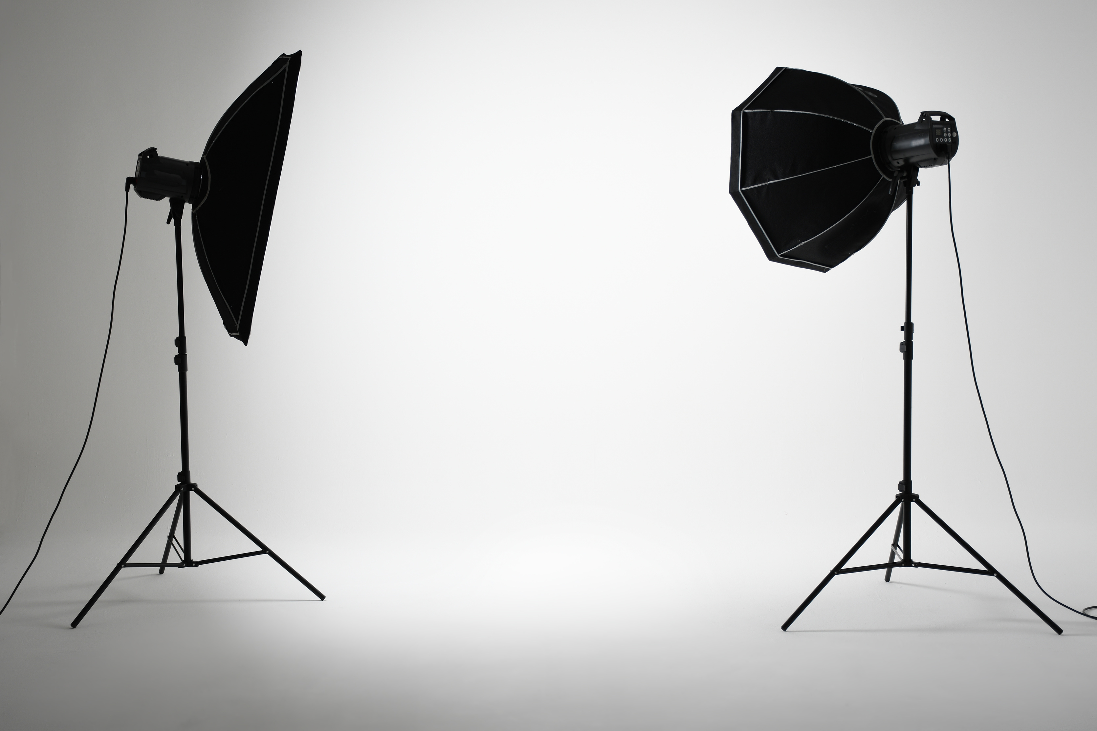
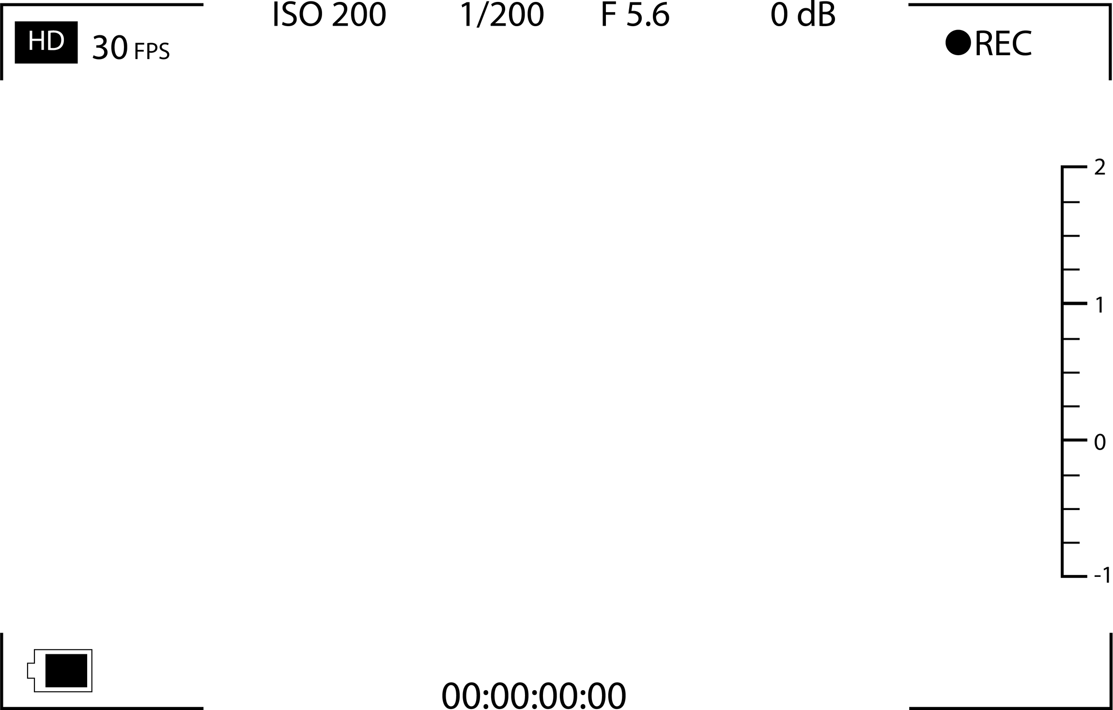

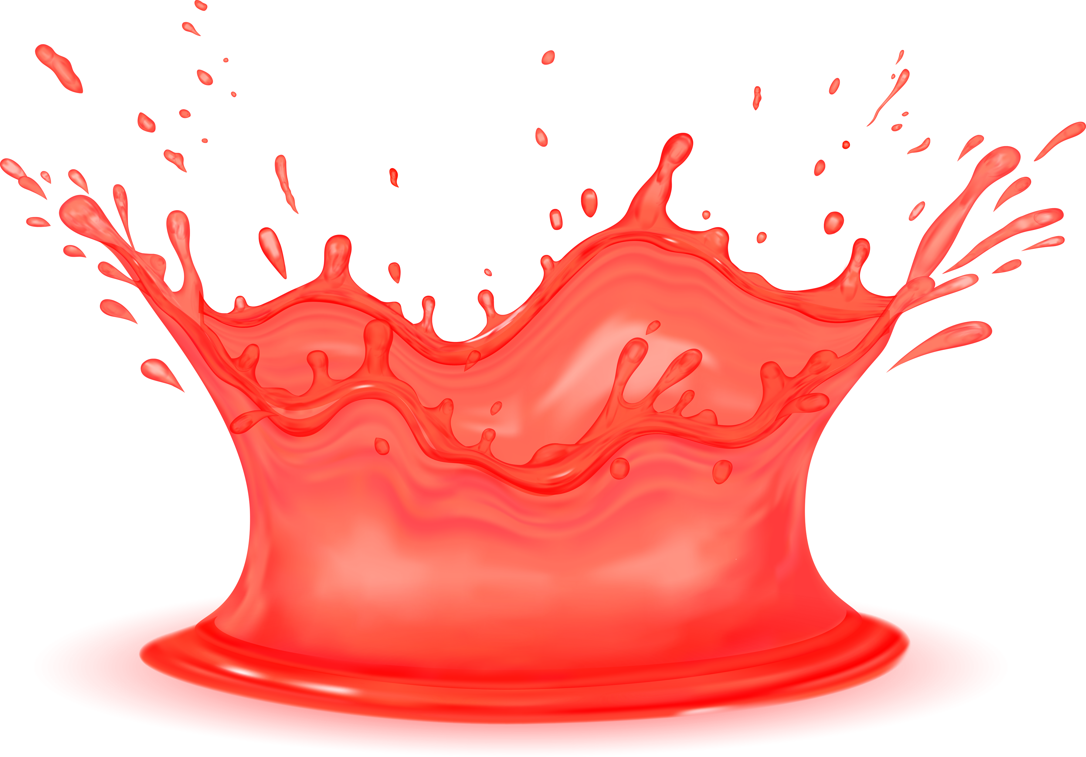
THE STORY OF
Freeze Pops
FREEZE THE FLAVOUR

Slide 2




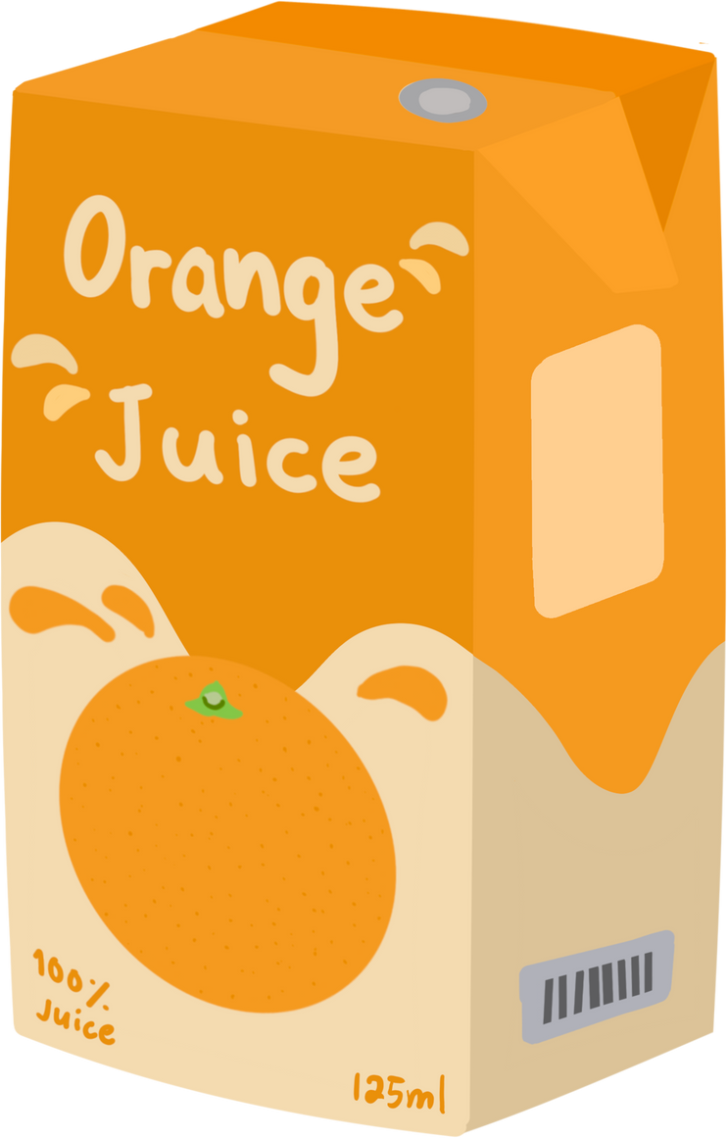


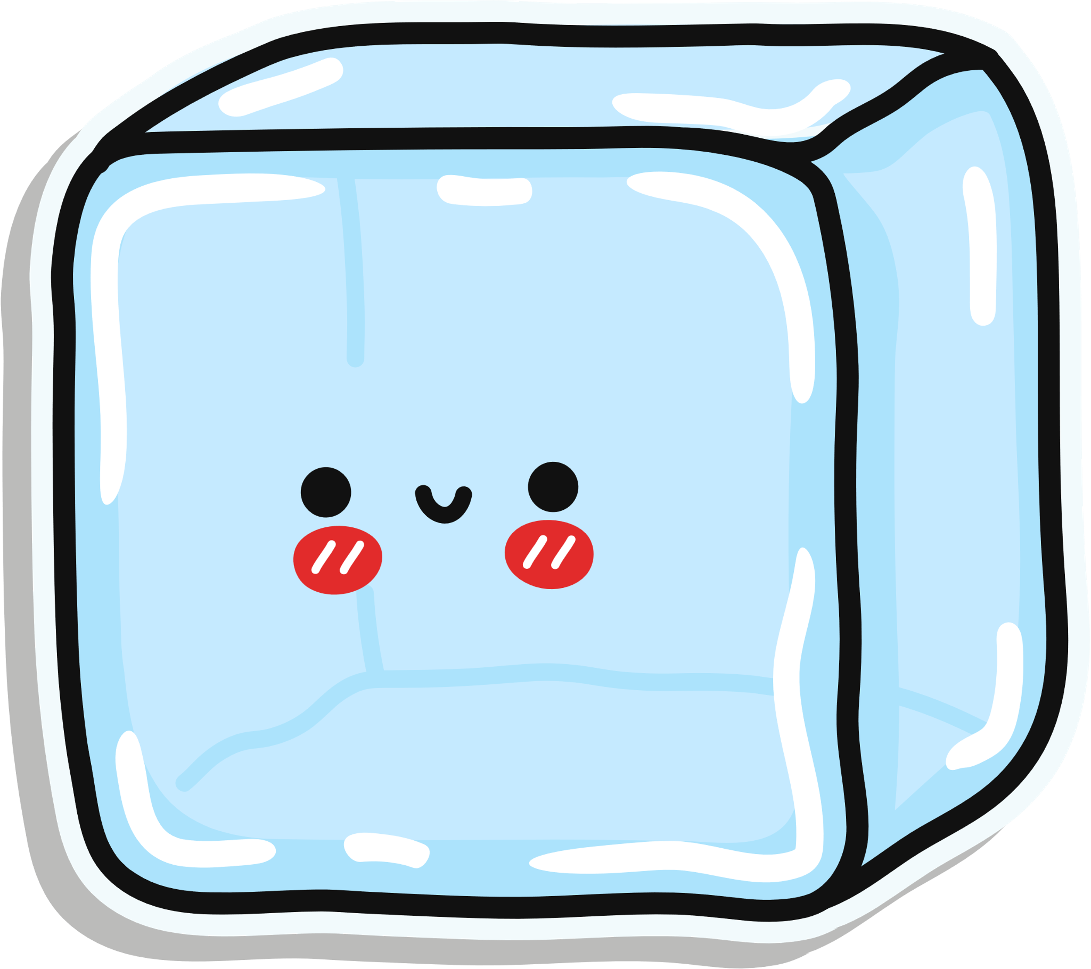
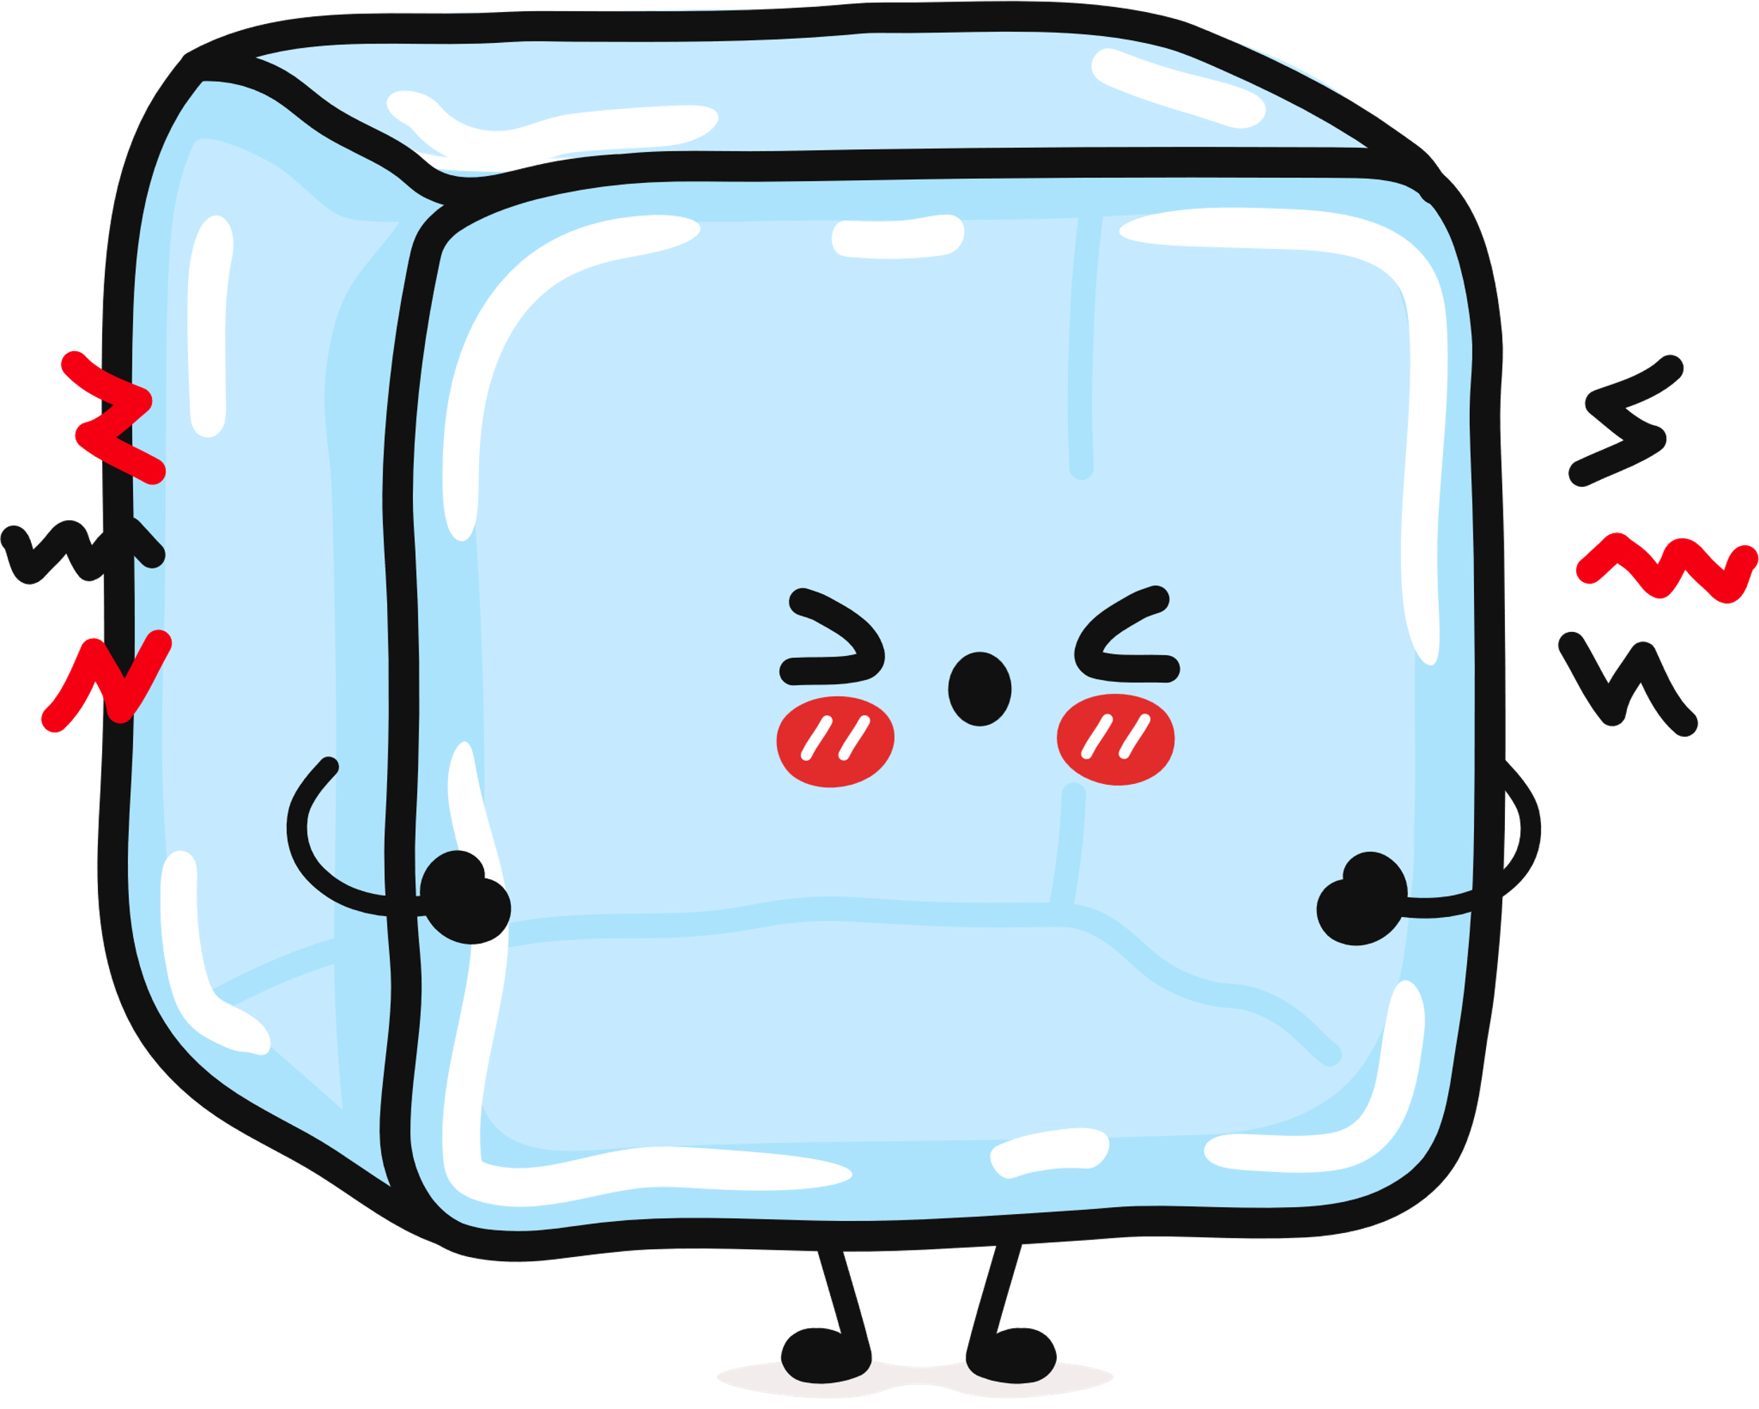
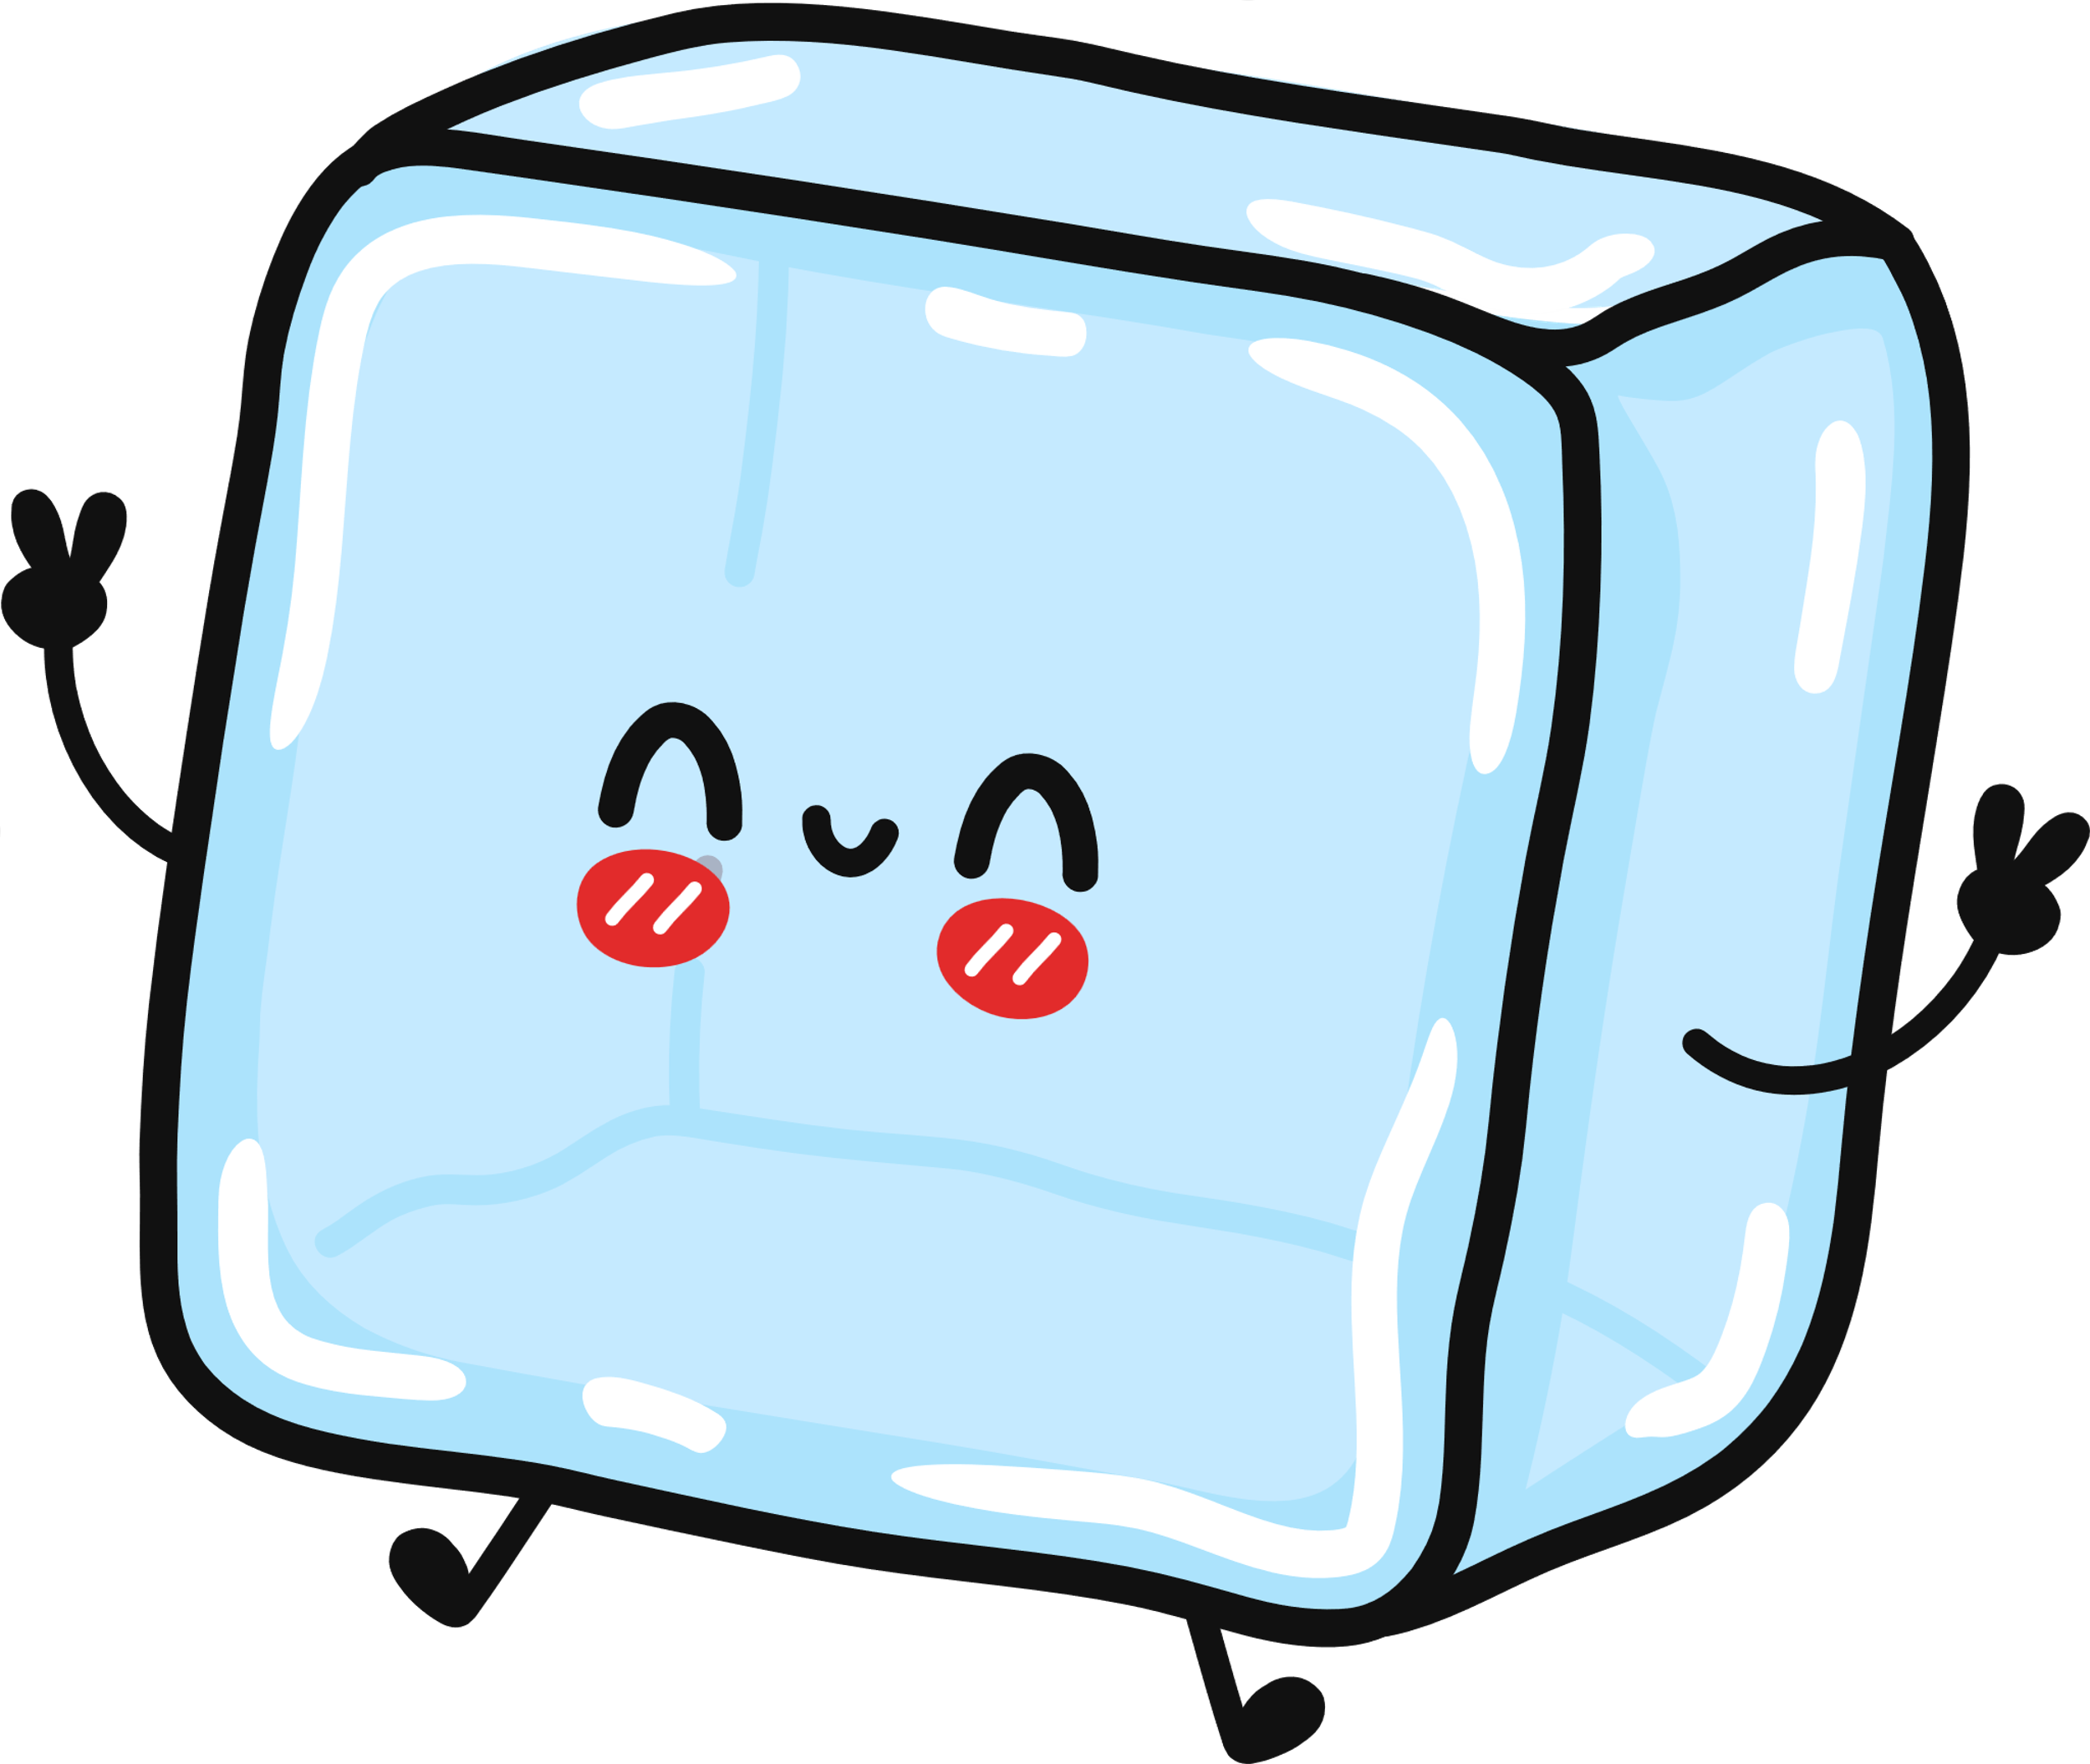
It all started when I was thinking of a product to create....to express and be people’s interest...
That said, I created freezepops ...

Slide 3
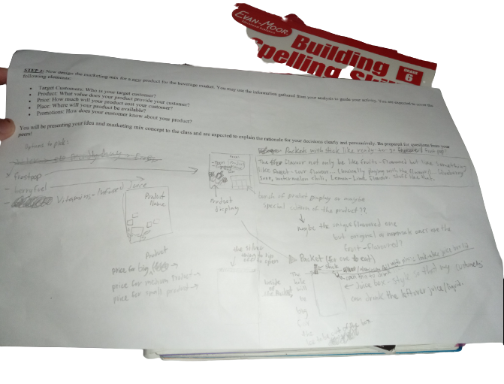

Slide 4






The Beverage Carton
A push-in lid made from the same material as the juice box, with a snug hole for the stick.
“ Frozen juice pop you can sip as it melts”

Slide 5

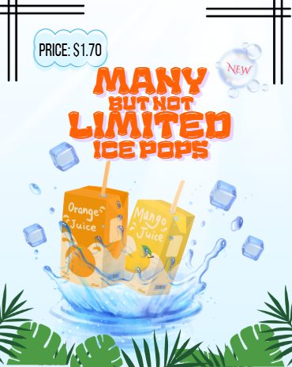

Slide 6
The targeted audience: 5+ years old
This product is made for people to enjoy their cold drink without losing their taste because the flavours like you saw, are unique and something new that people can try without having to eat fruit-flavoured which is common in the category, it’s just depends on the ingredient. Like each brand has their own touch or taste which is what gives their popularity. There isn’t any artificial flavours, because it’s the hard part, that’s why it’s a little expensive but if people enjoy the authentic, it’s worth a try.

